Slide 1
Capstone Engagement
Assessment, Analysis, and Hardening of a Vulnerable System

Slide 2
Table of Contents
This document contains the following sections:
01
Network Topology
02
Red Team: Security Assessment
03
Blue Team: Log Analysis and Attack Characterization
Hardening: Proposed Alarms and Mitigation Strategies
04

Slide 3
Network Topology
‹#›

Slide 4
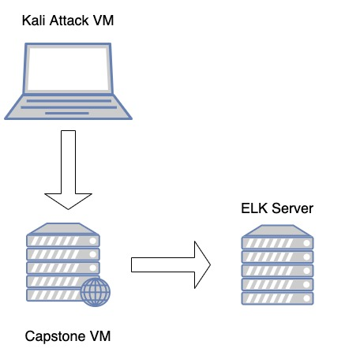
Network Topology
Network
Address Range:192.168.1.0/24
Netmask: 255.255.255.0
Gateway: 192.168.1.1
Machines
IPv4: 192.168.1.90
OS: Linux
Hostname: Kali
IPv4: 192.168.1.105
OS: Linux
Hostname: Capstone
IPv4:192.168.1.100
OS: Linux
Hostname: ELK

Slide 5

Red Team
Security Assessment
‹#›

Slide 6
Recon: Describing the Target
Nmap identified the following hosts on the network:
Hostname | IP Address | Role on Network
Intel Corporate | 192.168.1.100 | Stores the logs for the corporate server.
Microsoft | 192.168.1.105 | Machine on the corporate network.

Slide 7
Vulnerability Assessment
The assessment uncovered the following critical vulnerabilities in the target:
Vulnerability | Description | Impact
Use the CVE number if it exists. Otherwise, use the common name. | Describe the vulnerability. | Describe what this vulnerability allows the attacker to do.
Sensitive Data Exposure OWASP Top 10 #3 Critical | The secret_folder can be accessed by a public web page, but contains information for authorized users only. | This compromises login credentials that an attacker can use to gain access to the web server.
Unauthorized Uploads Critical | Users can upload anything they want to the web server. | This allows hackers to upload a PHP script to the server.
Injection OWASP Top 10 #1 Critical | Hackers can use PHP scripts to execute shell commands. | This vulnerability allows hackers to open a reverse shell to the server.

Slide 8
Exploitation: Sensitive Data Exposure
01
02
03
Tools & Processes
nmap to scan network
Browser to explore
hydra to brute force login credentials.
Achievements
Found there is a secret_folder directory.
This directory is password protected but susceptible to a brute force attack on the login credentials.
Found out the login credentials are:
U: ashton P: leopoldo
Exploitation
The login window reveals that the user is ashton.
This info was used to run a brute force attack to obtain login credentials.
Brute force syntax:
Hydra -l ashton -P rockyou.txt -s 80 -f -vV 192.168.1.105 http-get /company_folders/secret_folder/

Slide 9
Exploitation: Unauthorized Uploads
01
02
03
Tools & Processes
Using the cracked login info, found the folder containing the WebDAV connection instructions.
Used crackstation to obtain login for the provided hash and user ryan.
msfconsole to create custom web shell.
meterpreter to open connection to target.
Achievements
Uploaded a custom web shell containing a PHP script.
Exploitation
Logged in to the secret folder directory and ran the PHP script I uploaded. This opened a bash shell.

Slide 10
Exploitation: [Name of Third Vulnerability]
01
02
03
Tools & Processes
Used meterpreter to connect to my uploaded web shell.
Used this shell to explore the target.
Achievements
Once connected to the target using meterpreter, I have access to the full file system.
Aftermath
Using this bash shell to get into the target allowed me to look through the file system and capture the flag.
The flag was found in the root directory.

Slide 11

Blue Team
Log Analysis and Attack Characterization
‹#›

Slide 12
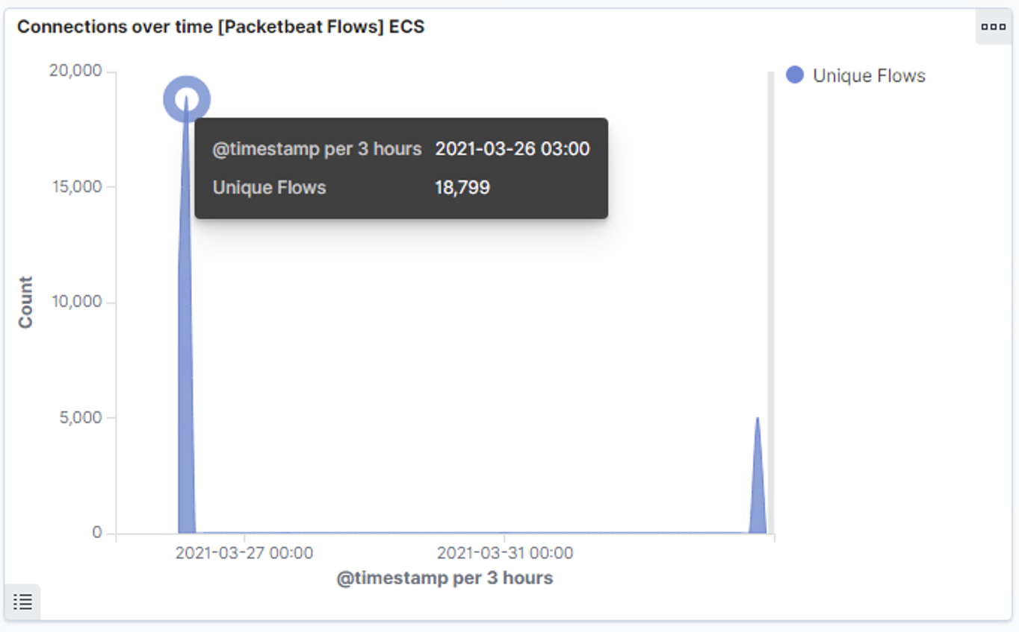
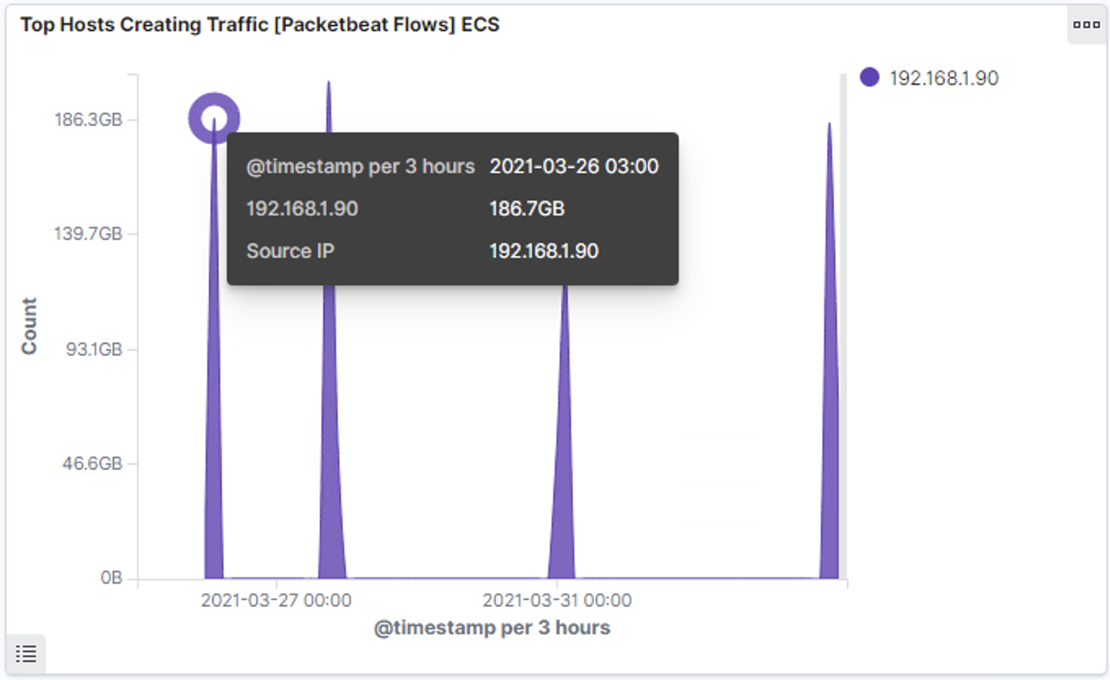
Analysis: Identifying the Port Scan
What time did the port scan occur? 3:00
How many packets were sent, and from which IP? In the first chart we see that 18,799 packets were sent. In the second chart we can see that the IP address is 192.168.1.90
What indicates that this was a port scan? The amount of packets that were sent.

Slide 13
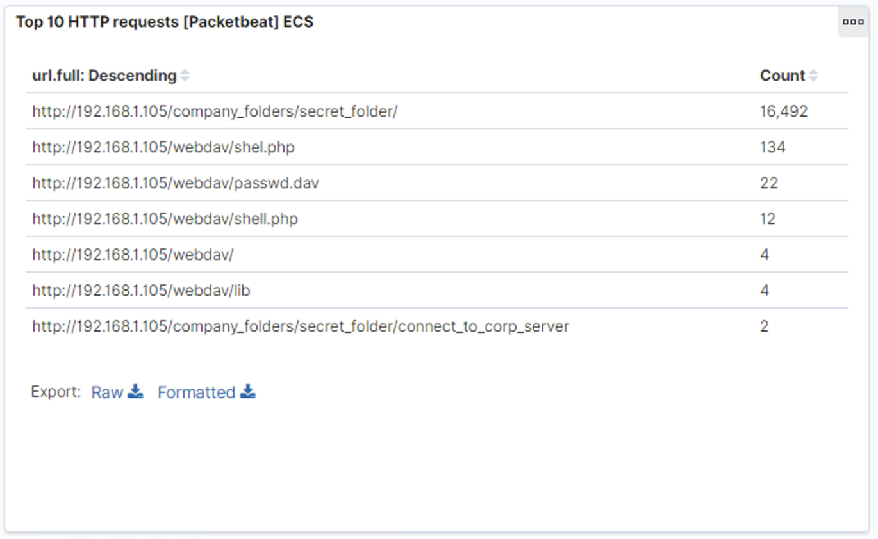
Analysis: Finding the Request for the Hidden Directory
What time did the request occur? How many requests were made? In the first chart we can see the attack started at 3:00 with 18,799 requests.
Which files were requested? What did they contain? In the second chart we can see which files were requested and what they contained.

Slide 14
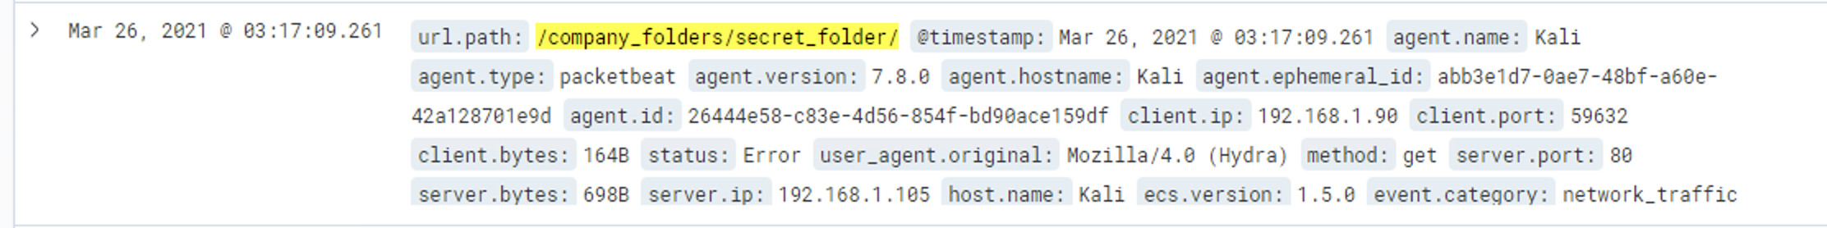
Analysis: Uncovering the Brute Force Attack
How many requests were made in the attack? In the first chart we see that 16,492 requests were made on the secret_folder.
How many requests had been made before the attacker discovered the password? Inside of the secret_folder directory there were only 2 requests, so out 16,492 requests only 2 were successful.

Slide 15
Analysis: Finding the WebDAV Connection
How many requests were made to this directory? There were 4 requests made to the webdav connection.
Which files were requested? The successful shell.php file was requested 12 times.

Slide 16
Blue Team
Proposed Alarms and Mitigation Strategies
‹#›

Slide 17
Mitigation: Blocking the Port Scan
What kind of alarm can be set to detect future port scans? We can set an alarm for the number of requests per second.
What threshold would you set to activate this alarm? The alarm should go off if we see more than 10 requests per second from a single IP address.
What configurations can be set on the host to mitigate port scans? A list of allowed IP address should be created. Also, a local firewall can be used to block incoming connections.

Slide 18
Mitigation: Finding the Request for the Hidden Directory
What kind of alarm can be set to detect future unauthorized access? An alarm that is triggered when an IP address that is not on the allowed list tries to connect.
What threshold would you set to activate this alarm? If the IP is allowed it won’t trigger, if the IP is NOT allowed it will go off.
What configuration can be set on the host to block unwanted access? A file with classified info should not be kept on the web server where it can be accessed by a public web page. At minimum the file should be encrypted.

Slide 19
Mitigation: Preventing Brute Force Attacks
What kind of alarm can be set to detect future brute force attacks? An alarm that triggers after a certain number of requests per second.
What threshold would you set to activate this alarm? It should be set to go off when more than 50 requests per second is exceeded.
What configuration can be set on the host to block brute force attacks? You can use two factor authentication and you could limit the number of failed login attempts.

Slide 20
Mitigation: Detecting the WebDAV Connection
What kind of alarm can be set to detect future access to this directory? You can set an alarm to go off if an unauthorized user or IP tries to access this directory. You can monitor access to this directory with Filebeat.
What threshold would you set to activate this alarm? If the user or IP is unauthorized, it goes off.
What configuration can be set on the host to control access? An admin must install filebeat on the host.

Slide 21
Mitigation: Identifying Reverse Shell Uploads
What kind of alarm can be set to detect future file uploads? You can set an alarm to go off if a forbidden file type is uploaded to this directory. For example a .php file like the one used in this attack.
What threshold would you set to activate this alarm? The alarm would trigger whenever a forbidden file type is uploaded.
What configuration can be set on the host to block file uploads? Permissions on the host can be restricted. Filebeat needs to be enabled and configured.

